Slide 1
Probability Review
TexPoint fonts used in EMF.
Read the TexPoint manual before you delete this box.: AAAAAAAAA

Slide 2
Outline
Random variables
Jointly distributed random variables
Probabilistic setting for classification
Bayes classifier

Slide 3
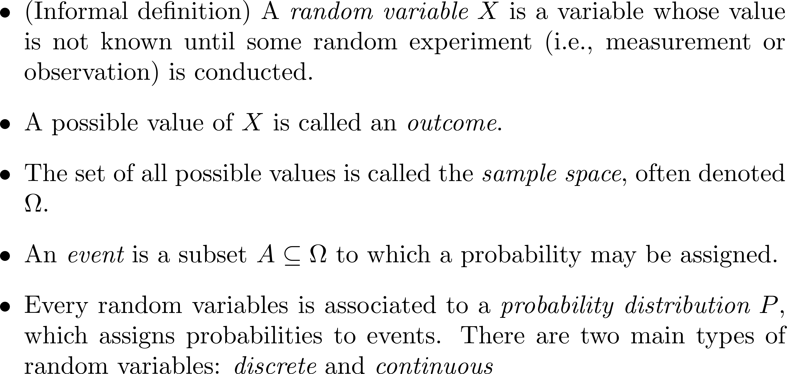
Random Variables

Slide 4
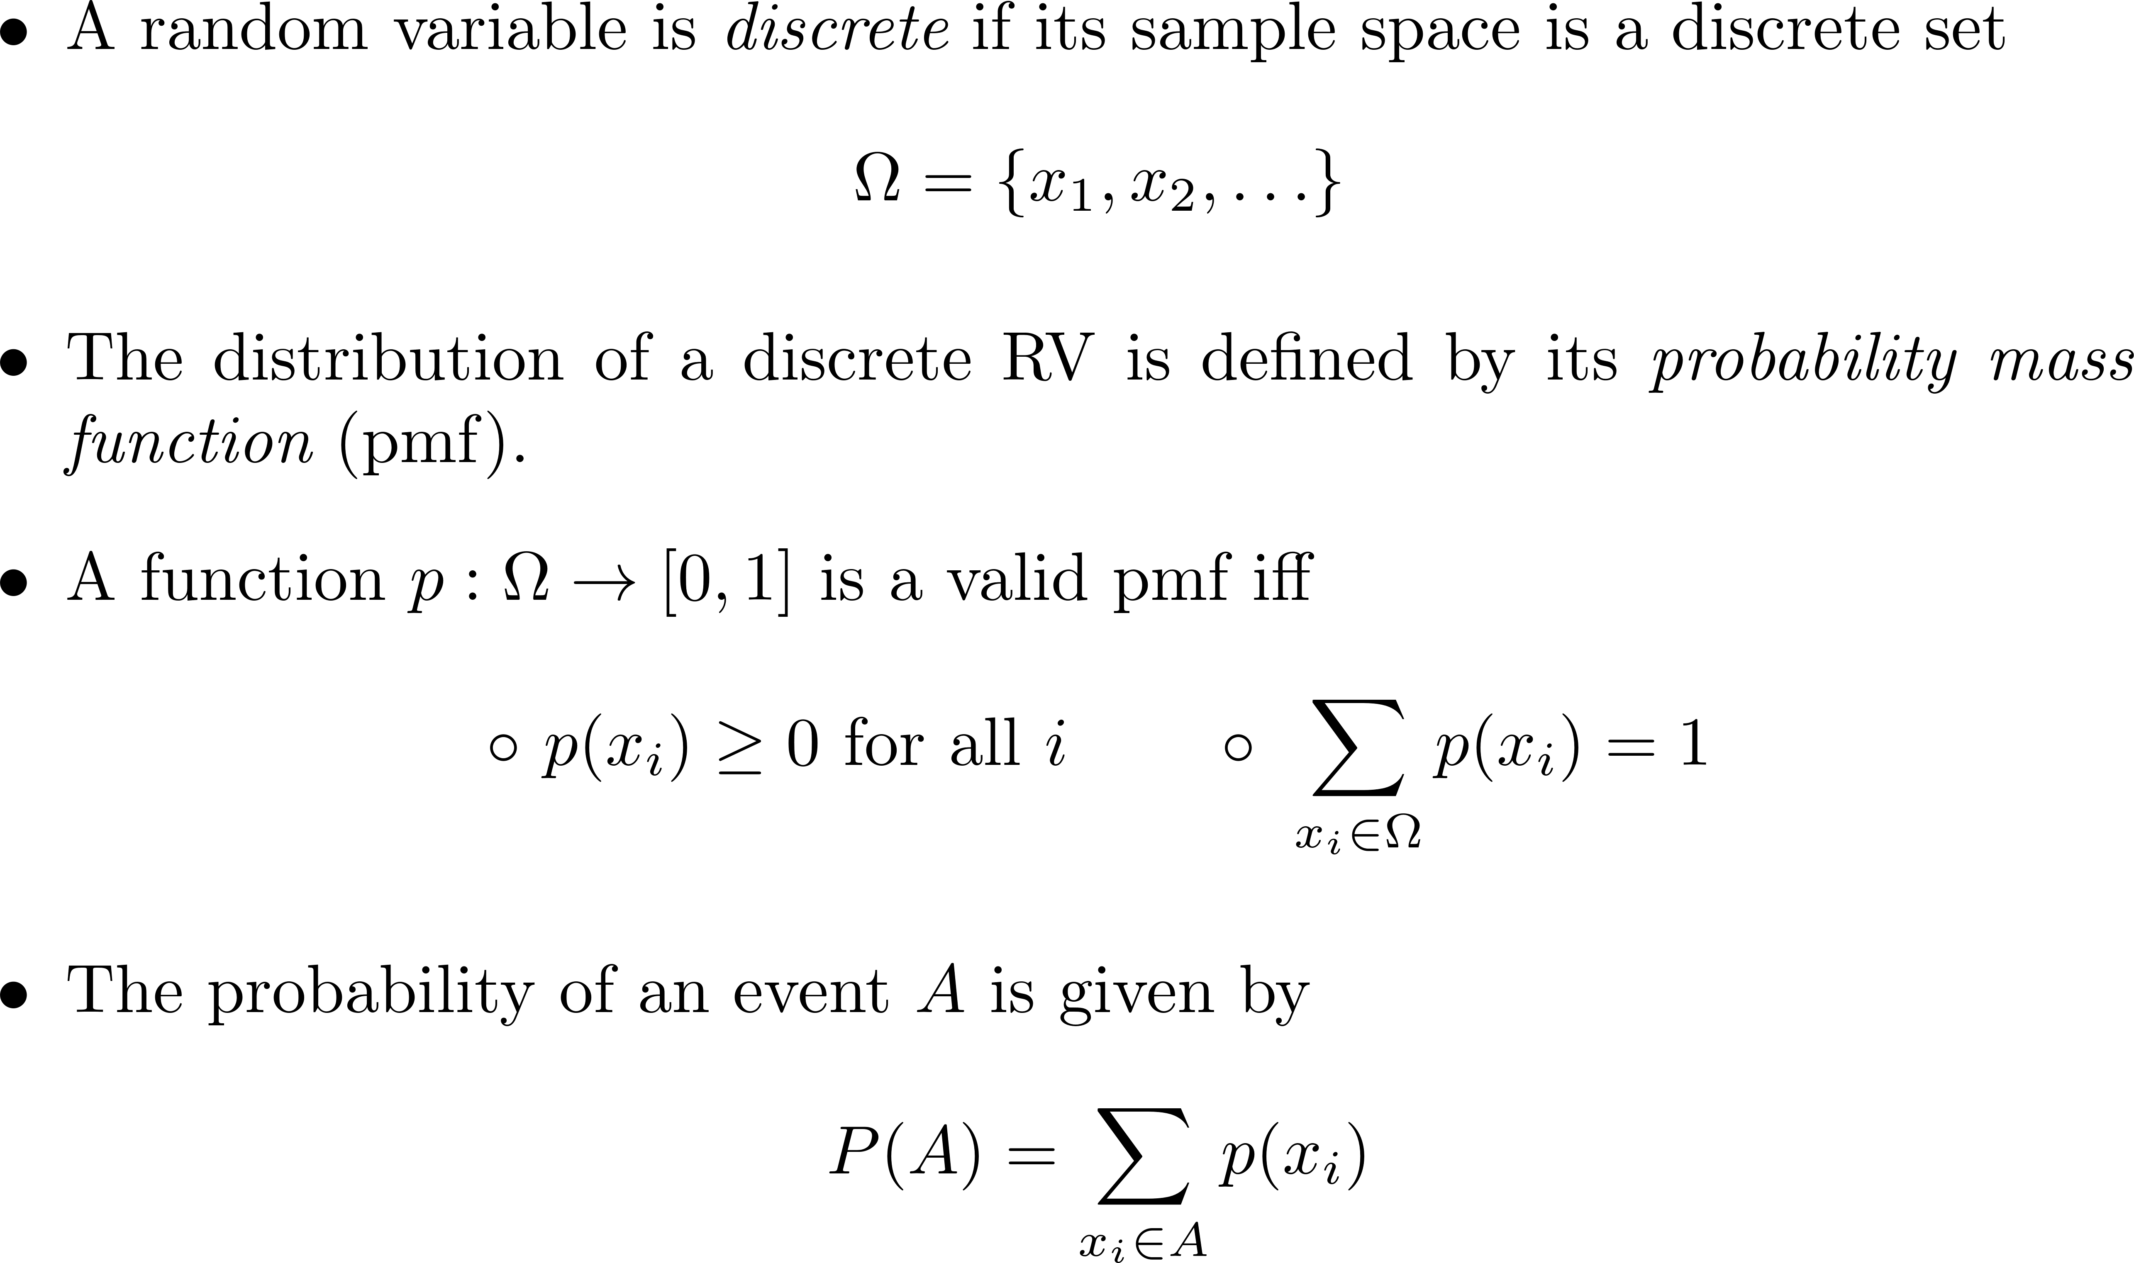
Discrete Random Variables

Slide 5

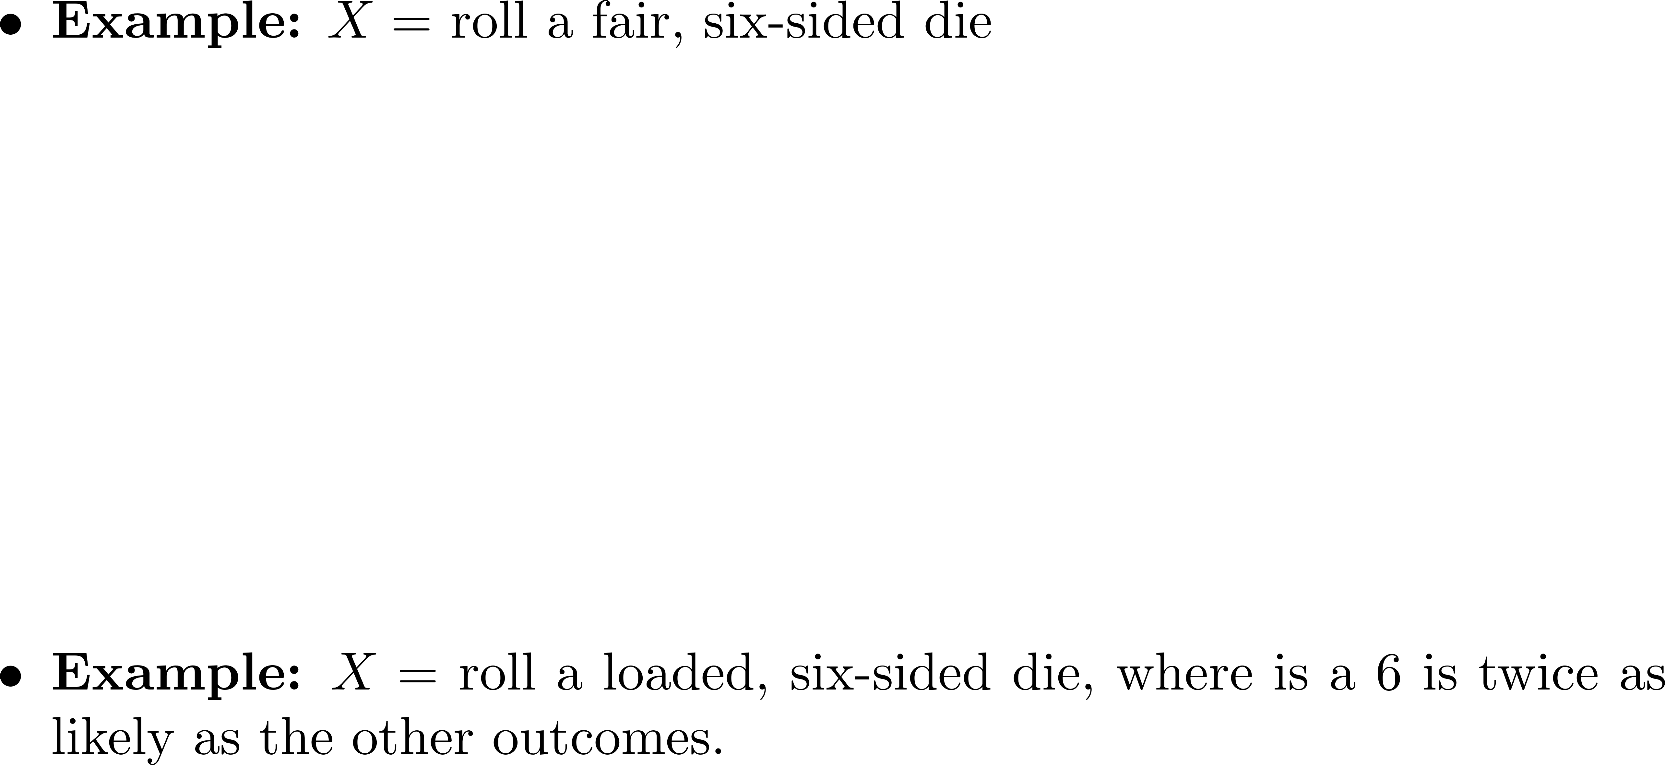
Examples of Discrete RVs

Slide 6
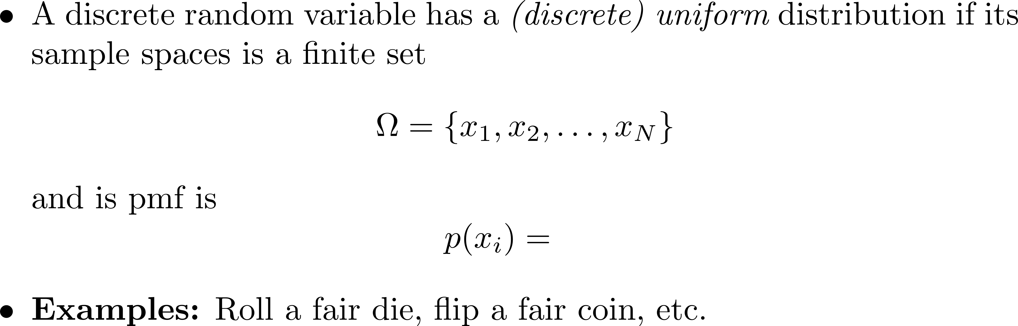
Discrete Uniform Distribution

Slide 7
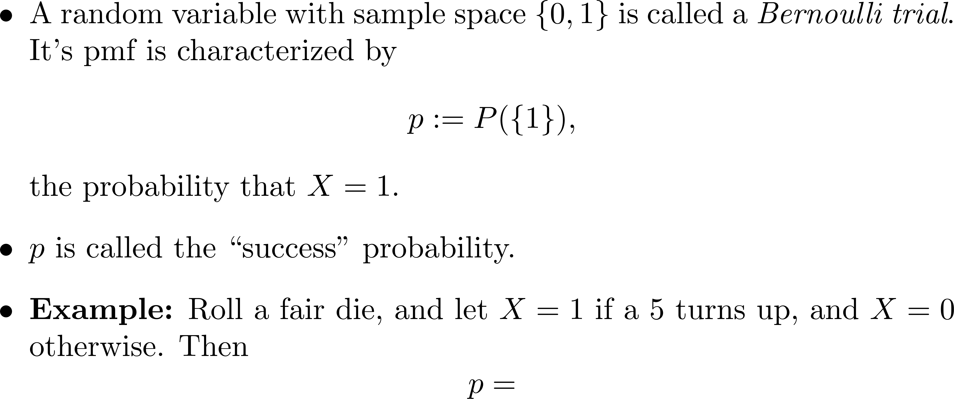
Bernoulli Trials

Slide 8
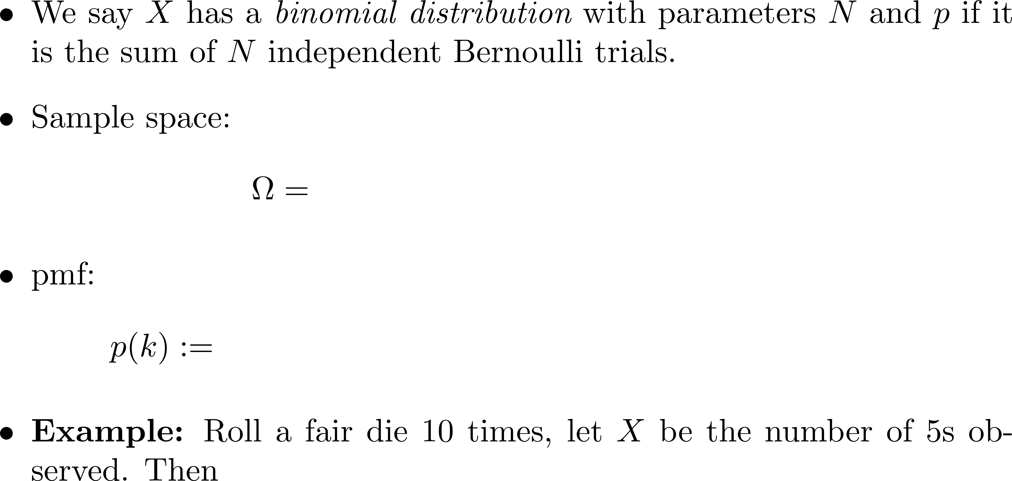
Binomial Distribution

Slide 9
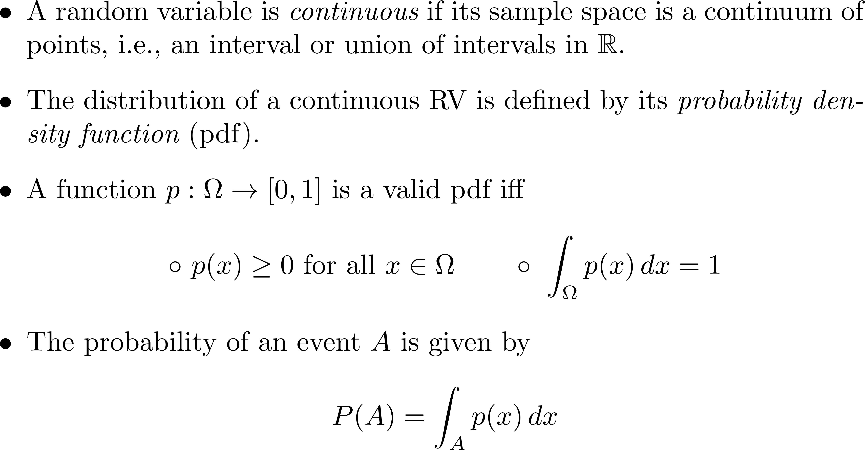
Continuous Random Variables

Slide 10
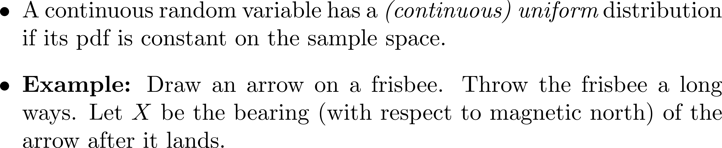

Continuous Uniform Distribution

Slide 11
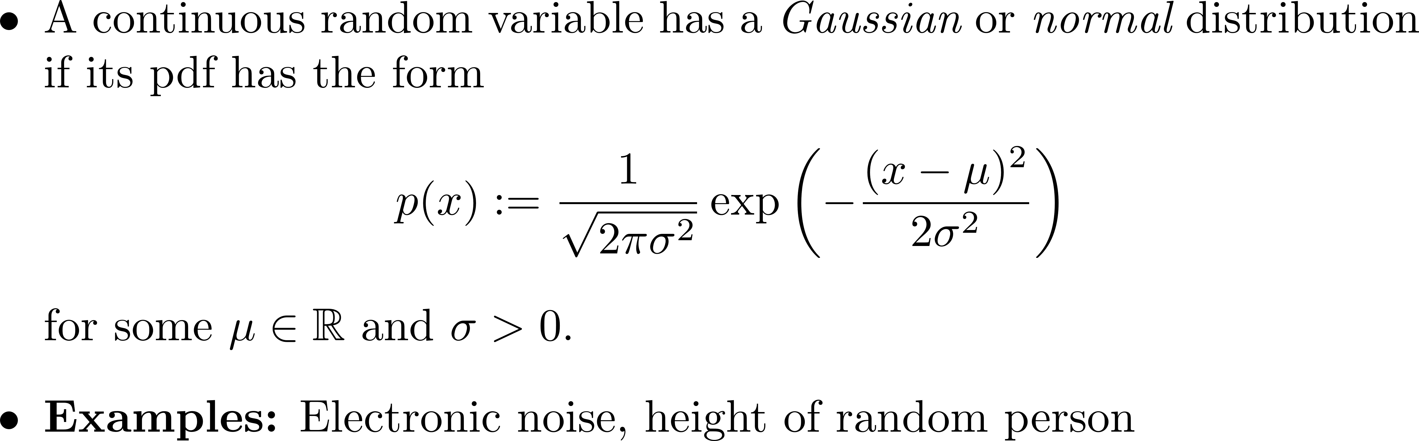
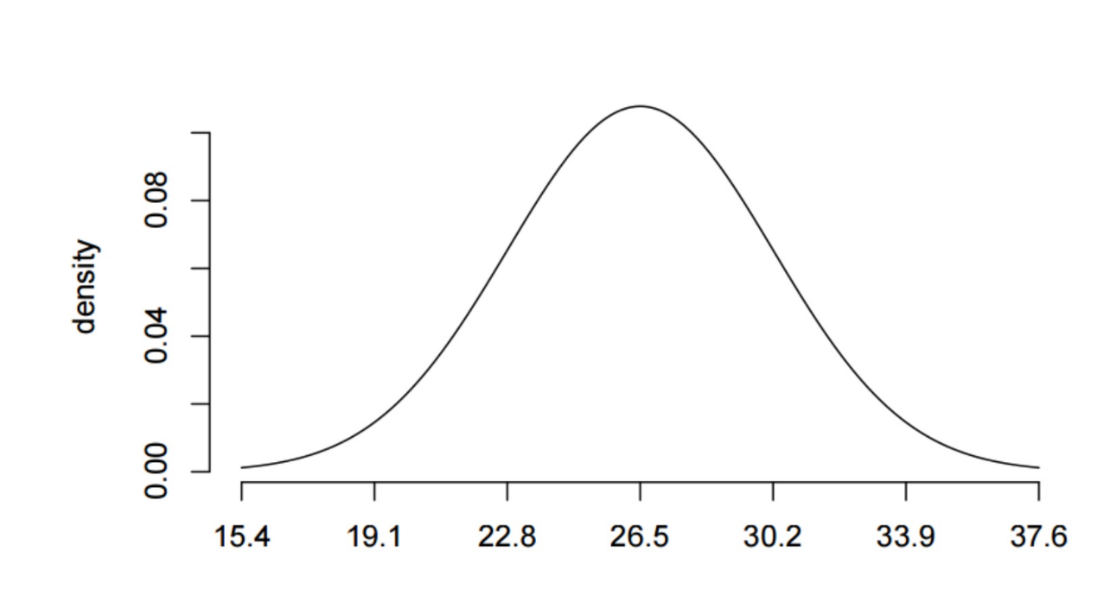
Gaussian Distribution

Slide 12
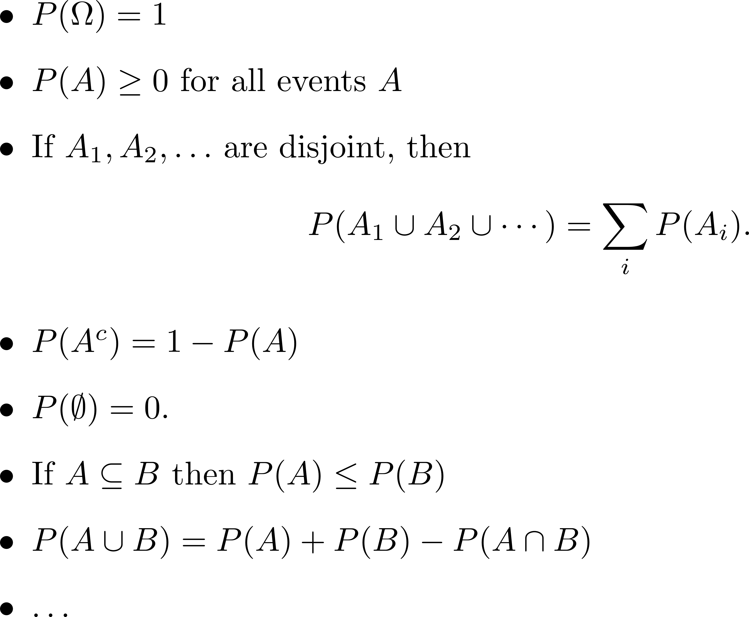
Properties of Probability Distributions

Slide 13
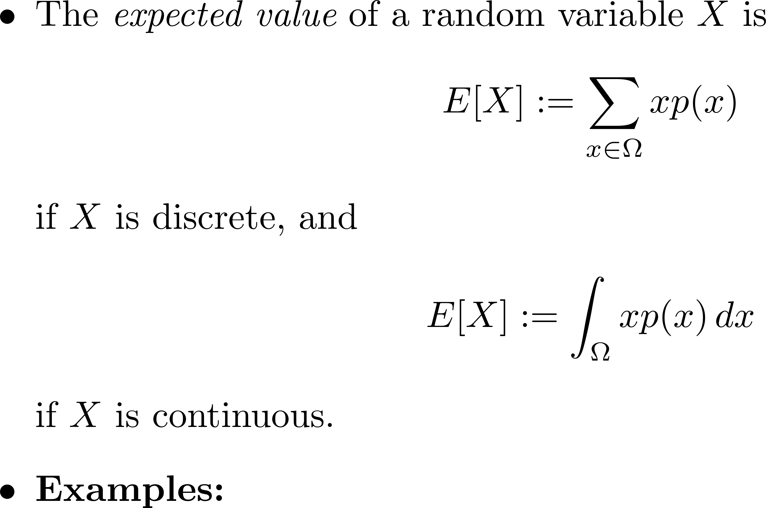
Expectation

Slide 14
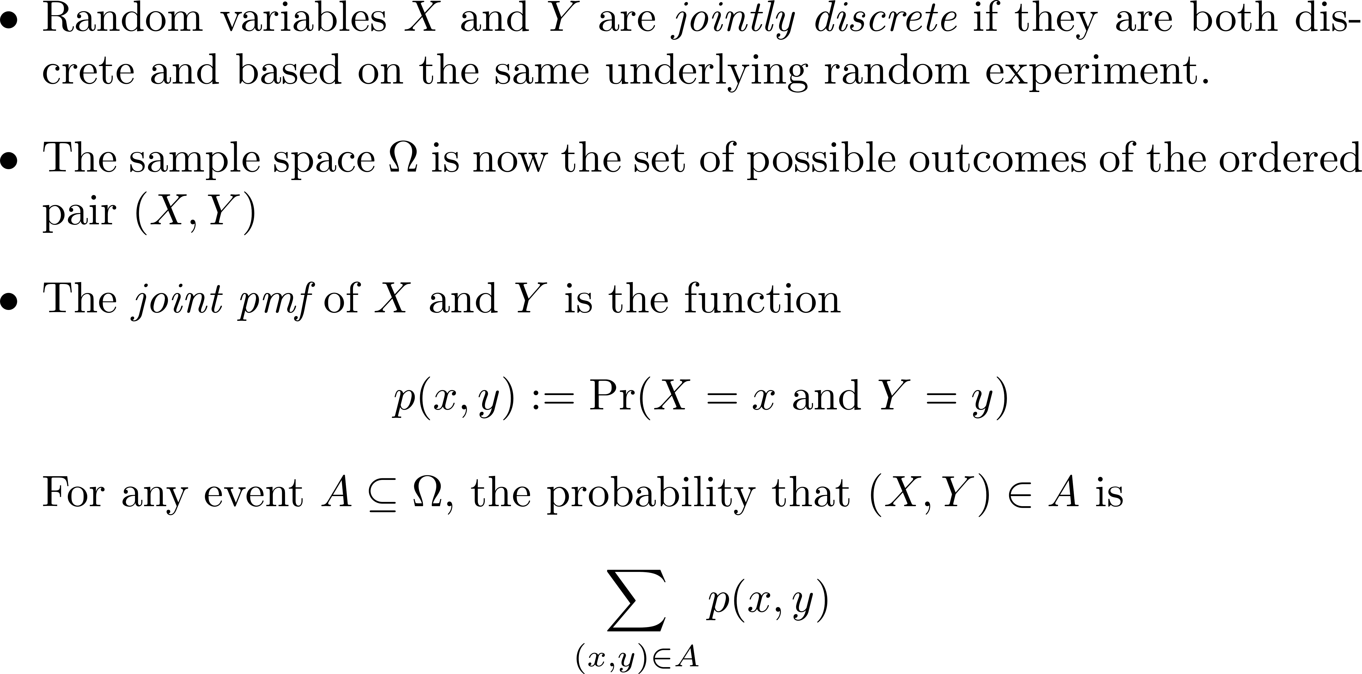
Jointly Distributed Random Variables

Slide 15
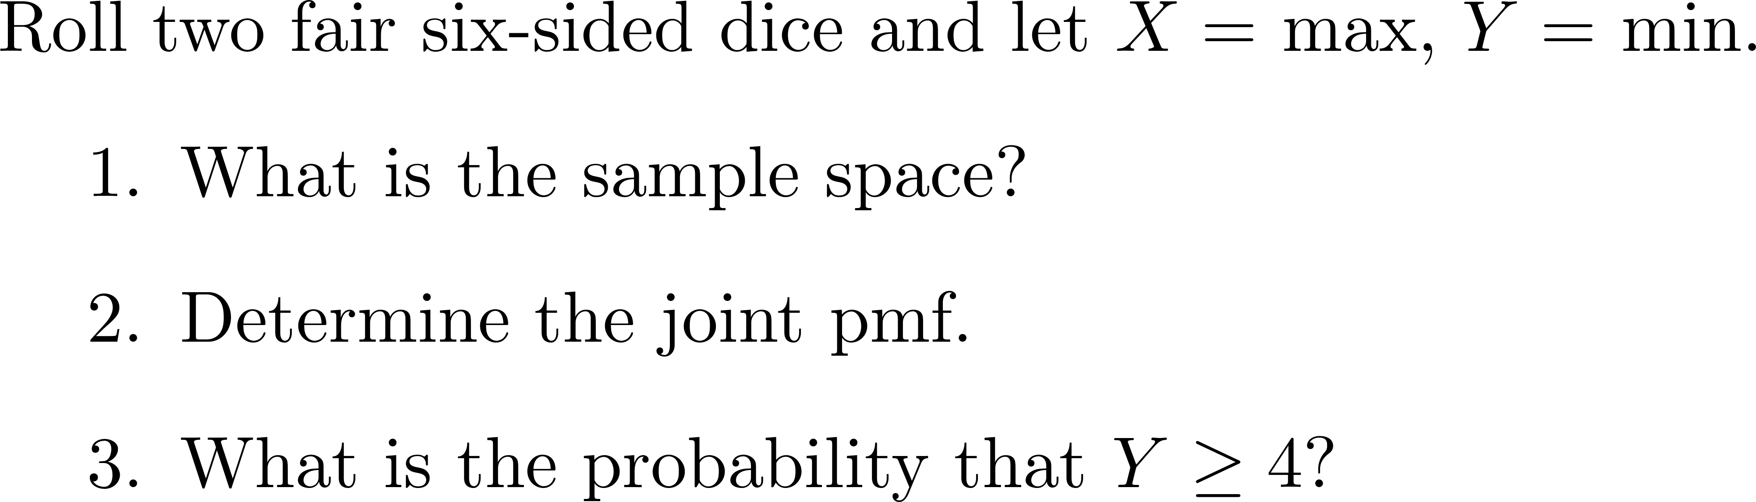
Group Exercise

Slide 16
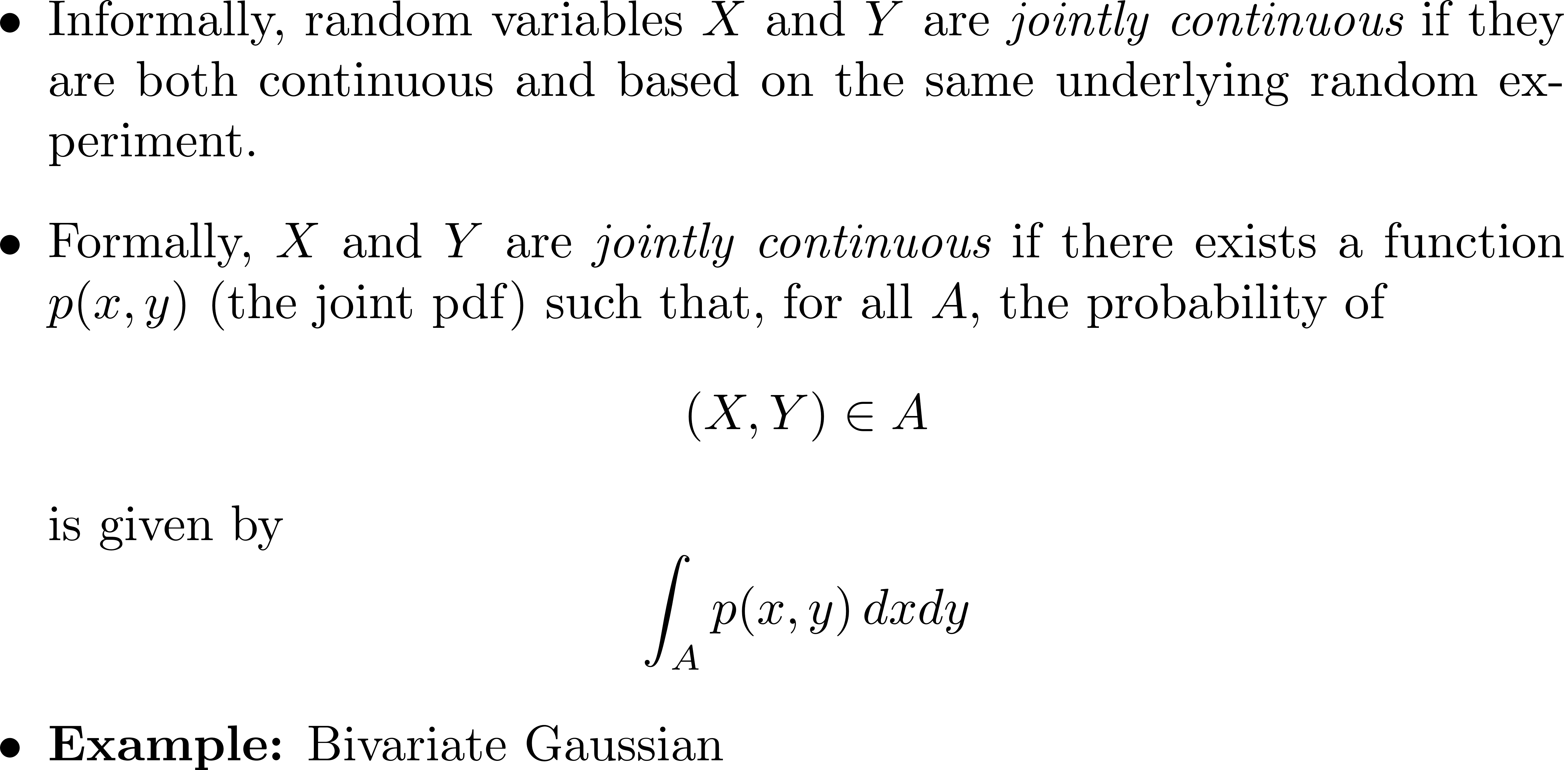
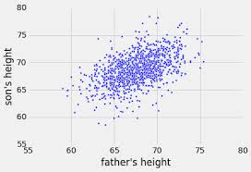
Jointly Distributed Random Variables

Slide 17
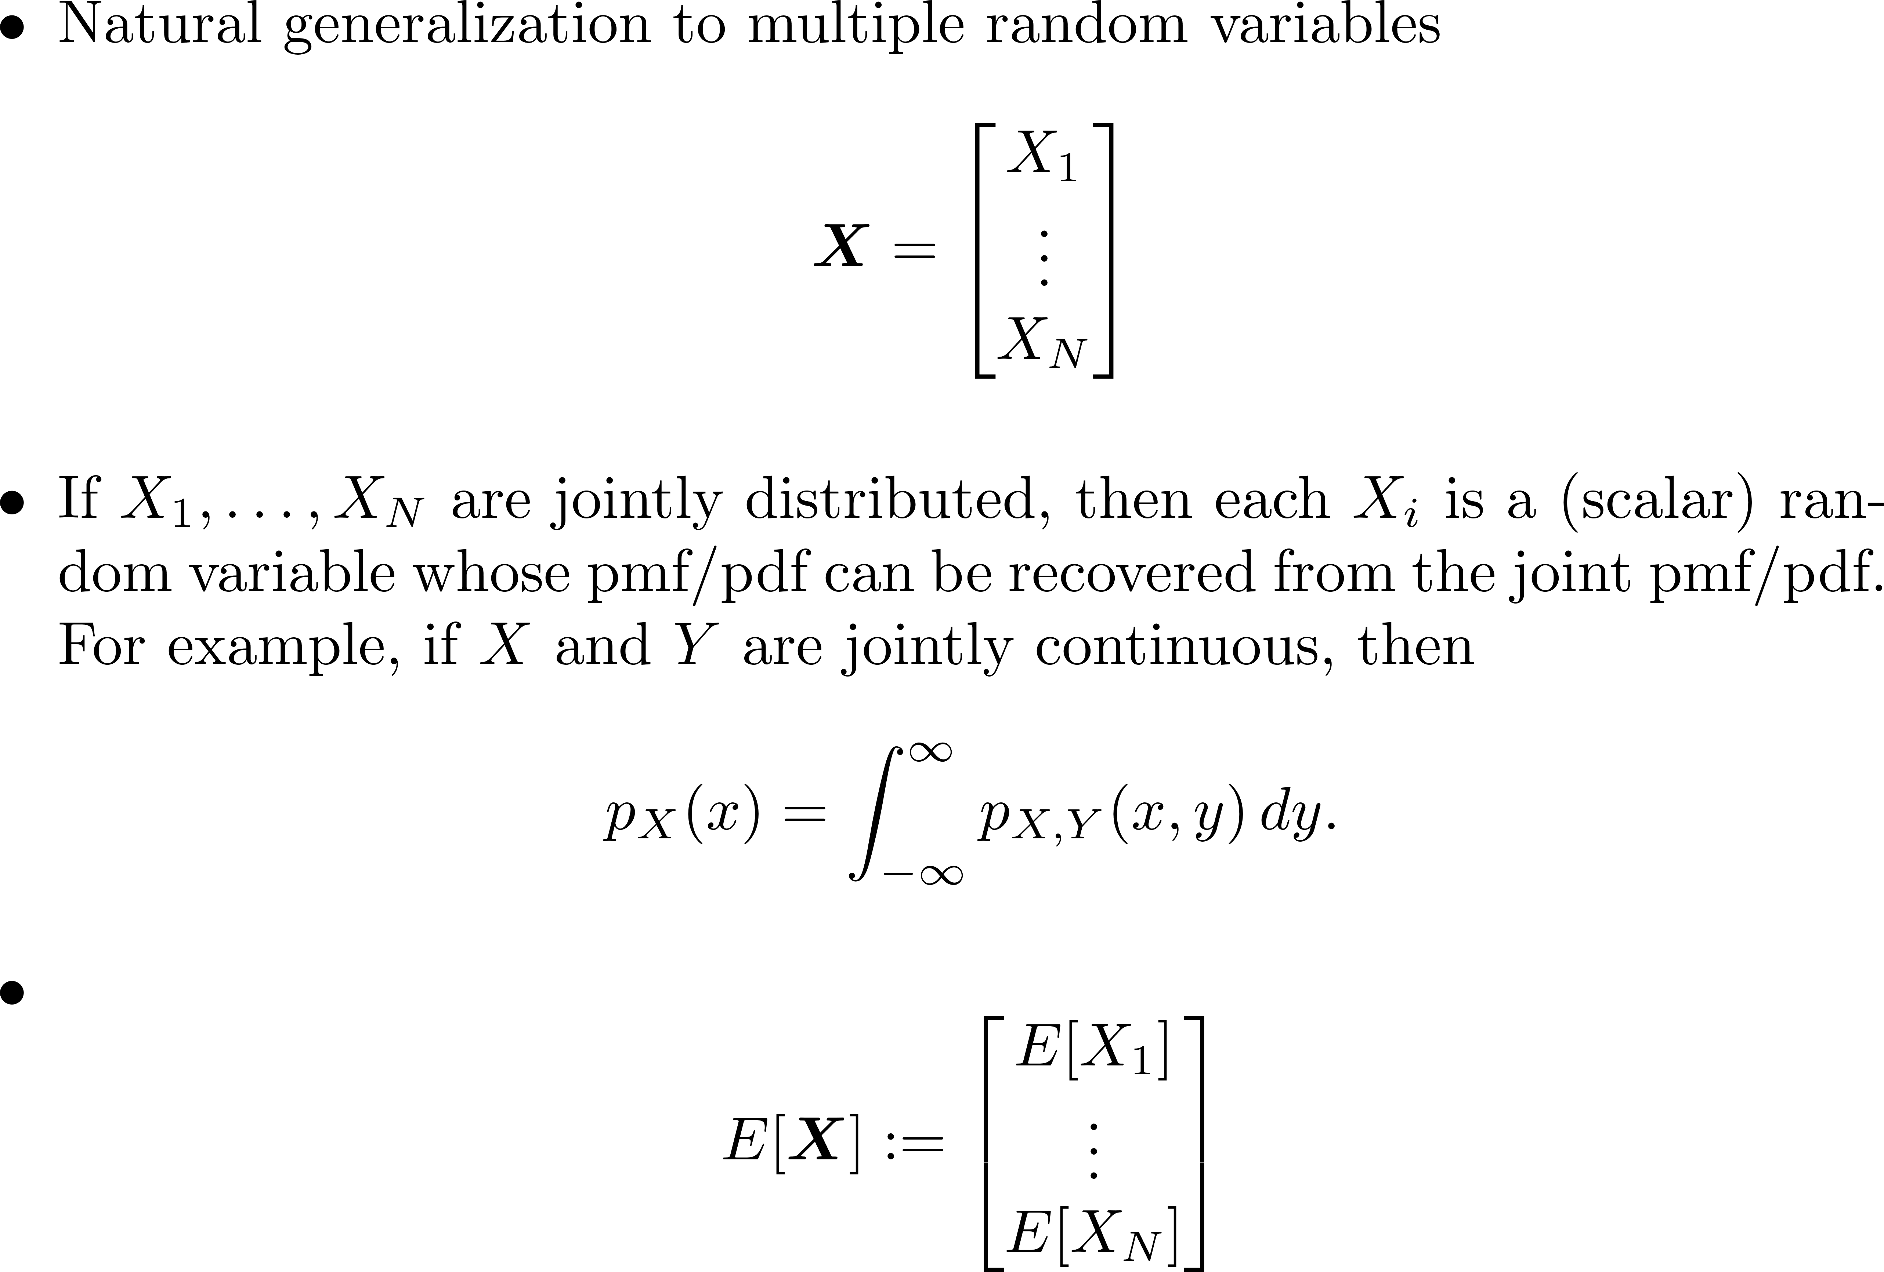
Jointly Distributed Random Variables

Slide 18
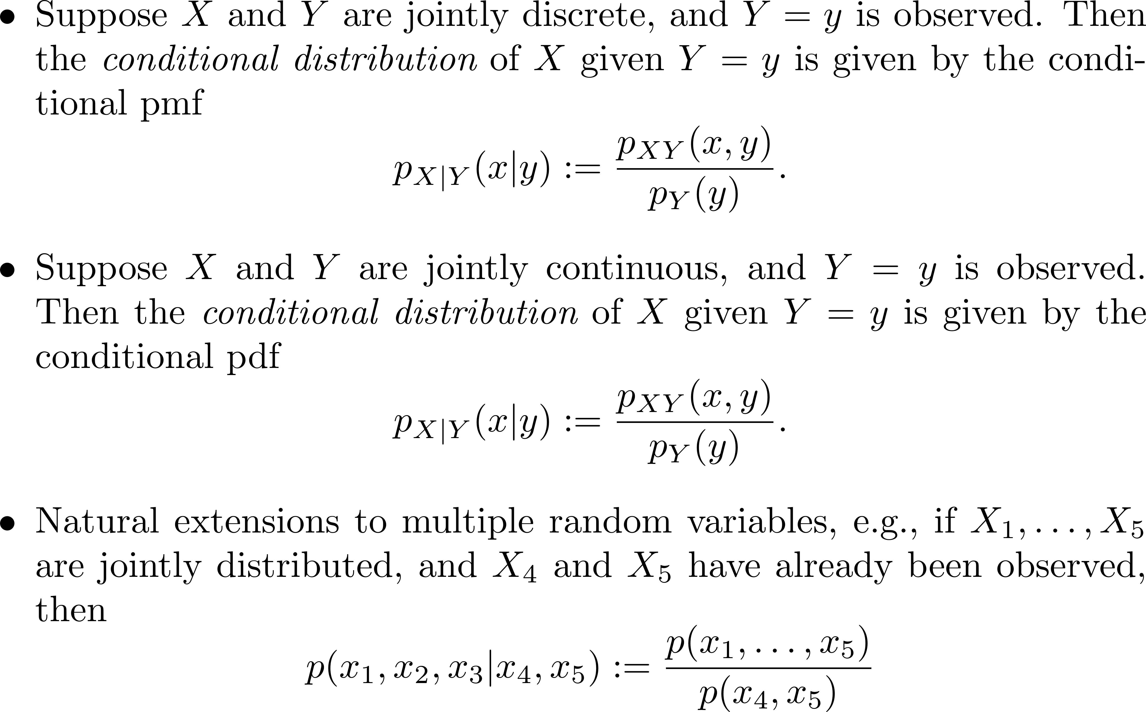
Conditional Distributions

Slide 19
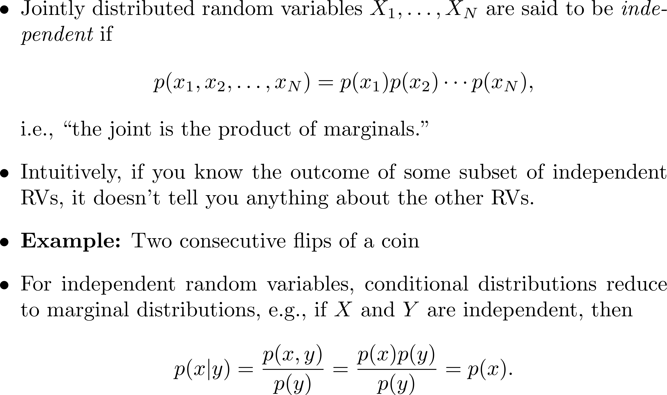
Independent Random Variables

Slide 20
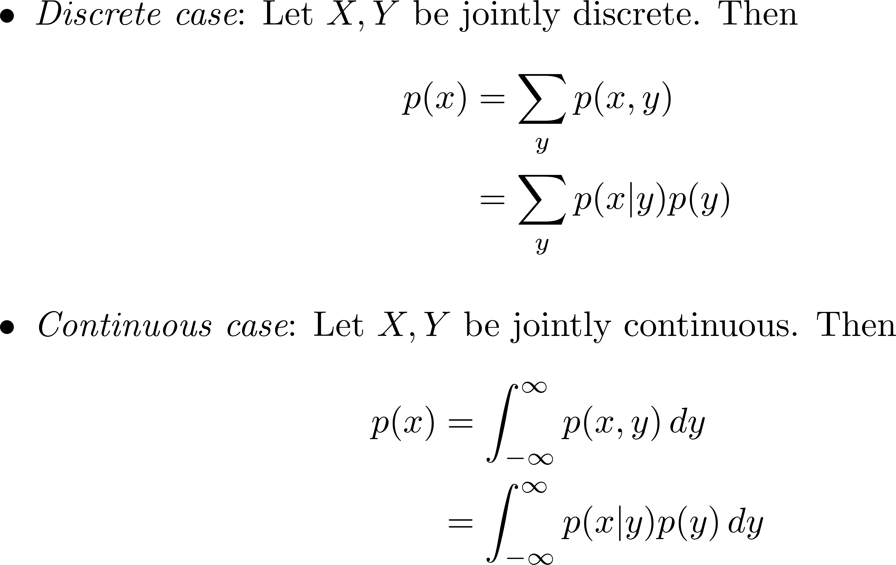
Law of Total Probability

Slide 21
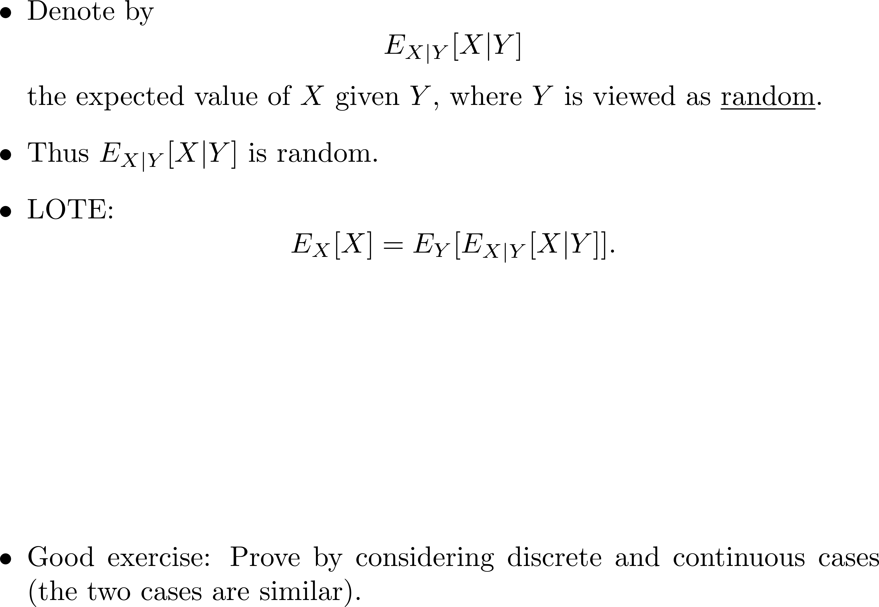
Law of Total Expectation

Slide 22
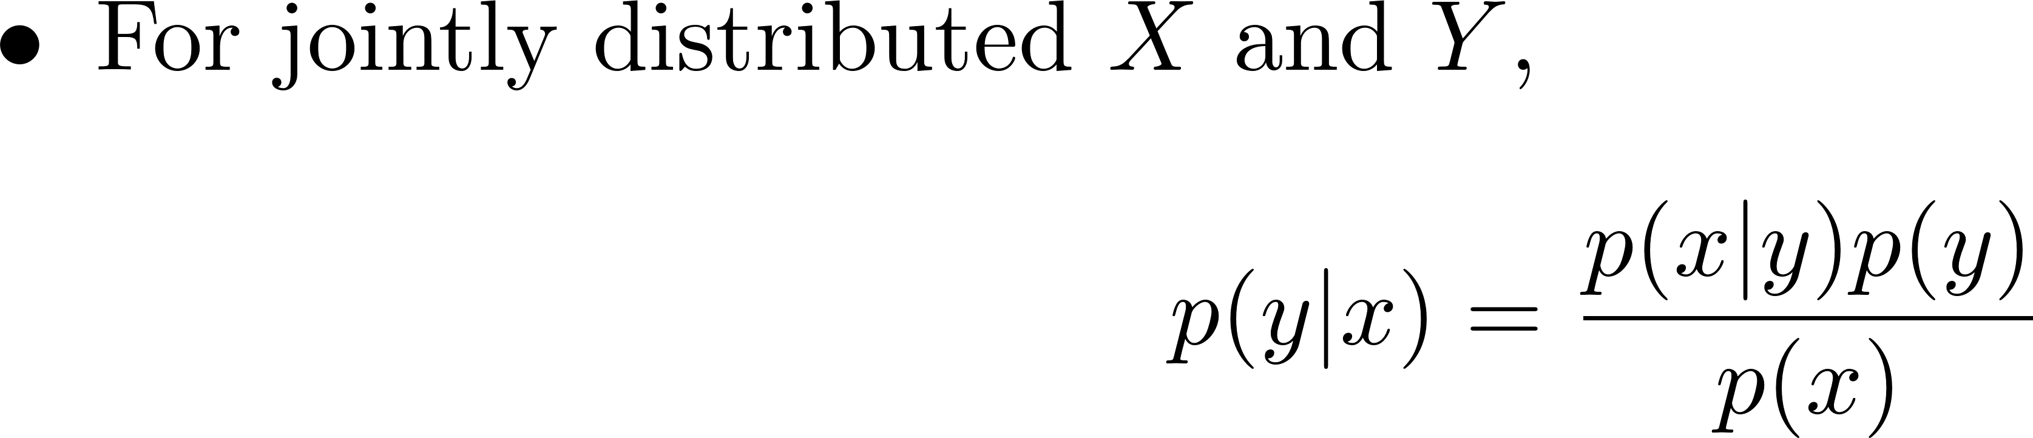
Bayes Rule

Slide 23
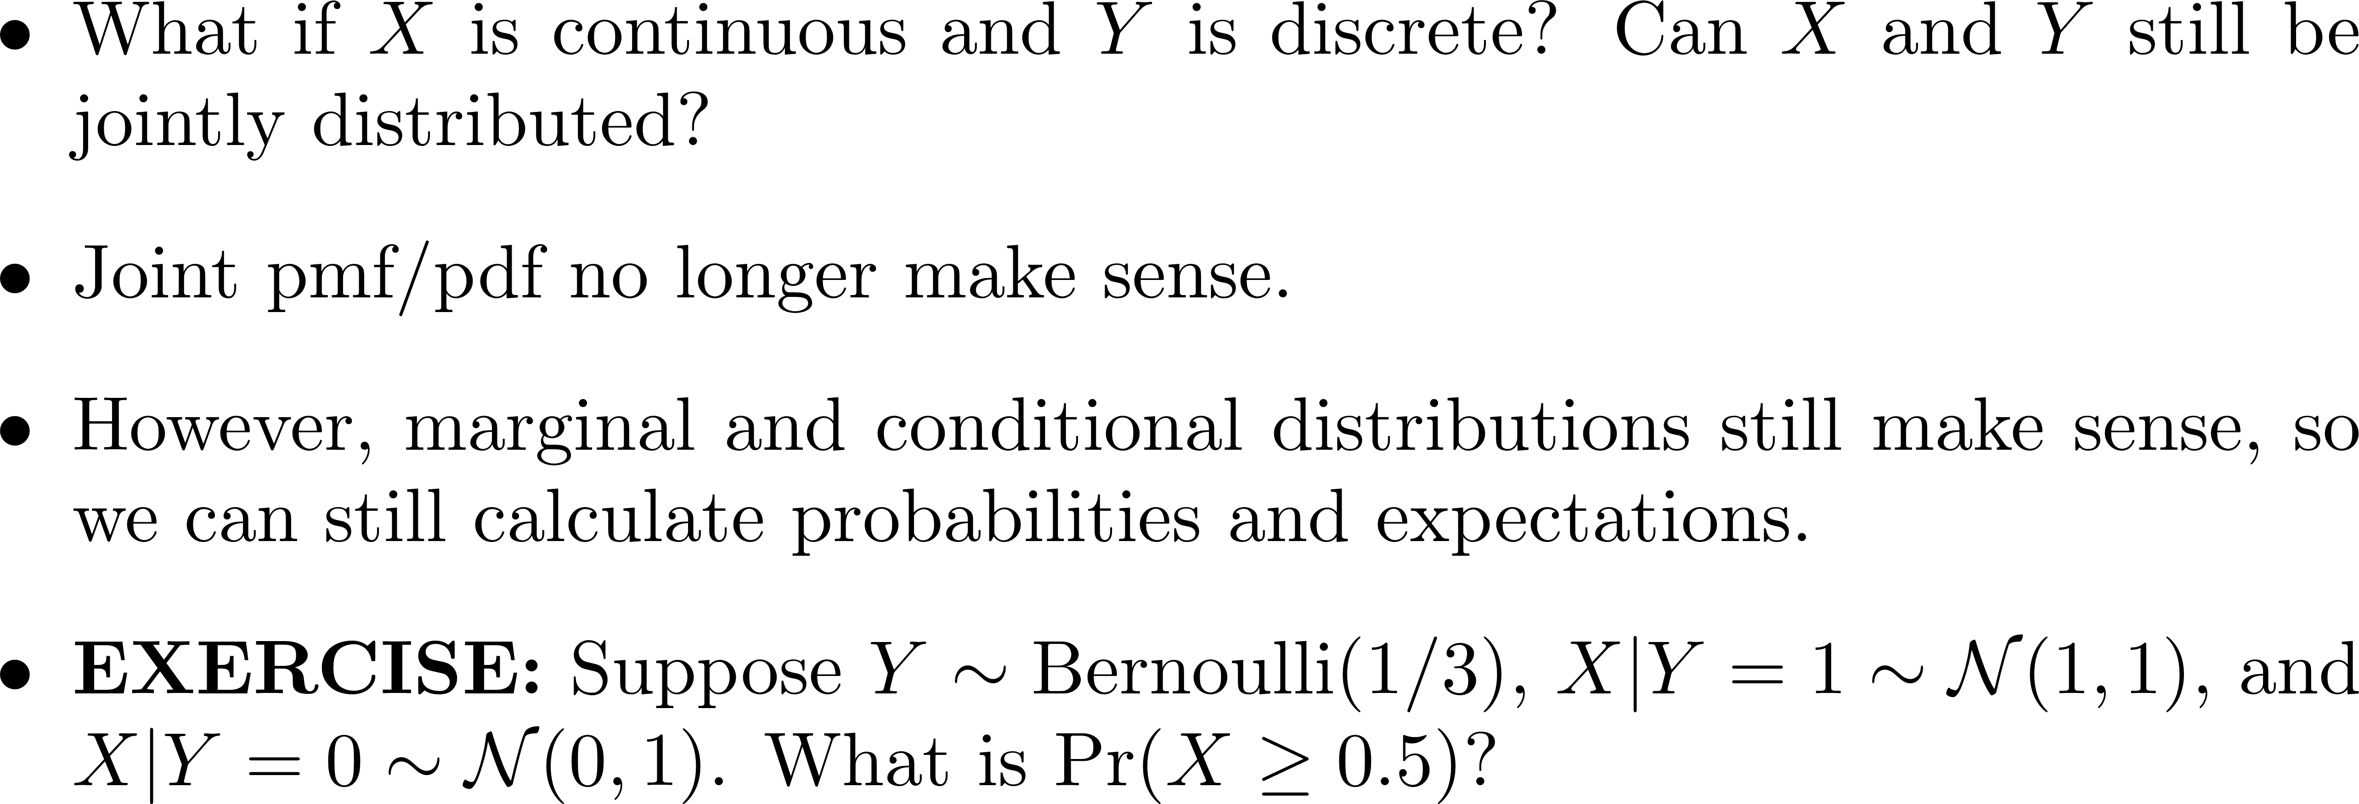
Mixed Case

